Slide 1
Monocular Visual Odometry
Atharva Paralikar & Hemanth Joseph Raj
117396560 117518955

Slide 2
Project Scope
Main Goal: Develop a working code for Monocular Visual Odometry and test it on the provided dataset (Oxford Robot Car dataset)
Ambitious Goal 1: Record a custom dataset using mobile camera, perform calibration for it and perform Visual Odometry on the dataset
Ambitious Goal 2: Extract the camera feed from a turtlebot in a Gazebo world and perform Visual Odometry in real-time

Slide 3
Visual Odometry - A background
Necessity?
Robots with Non-standard locomotion
Errors in regular odometry
Solutions
Traditional - Feature based
Recent research developments - Pixel Intensities, hybrid and Learning based-methods.

Slide 4
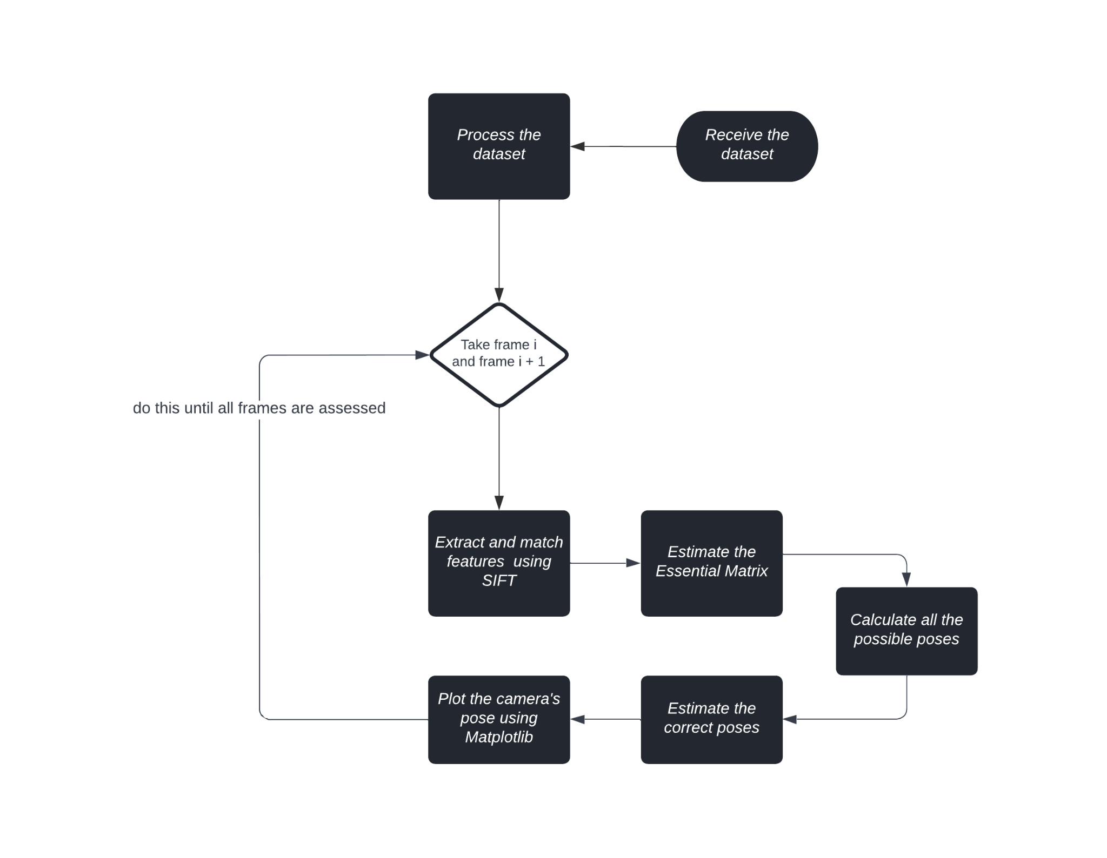
Conceptual Flow-Chart

Slide 5
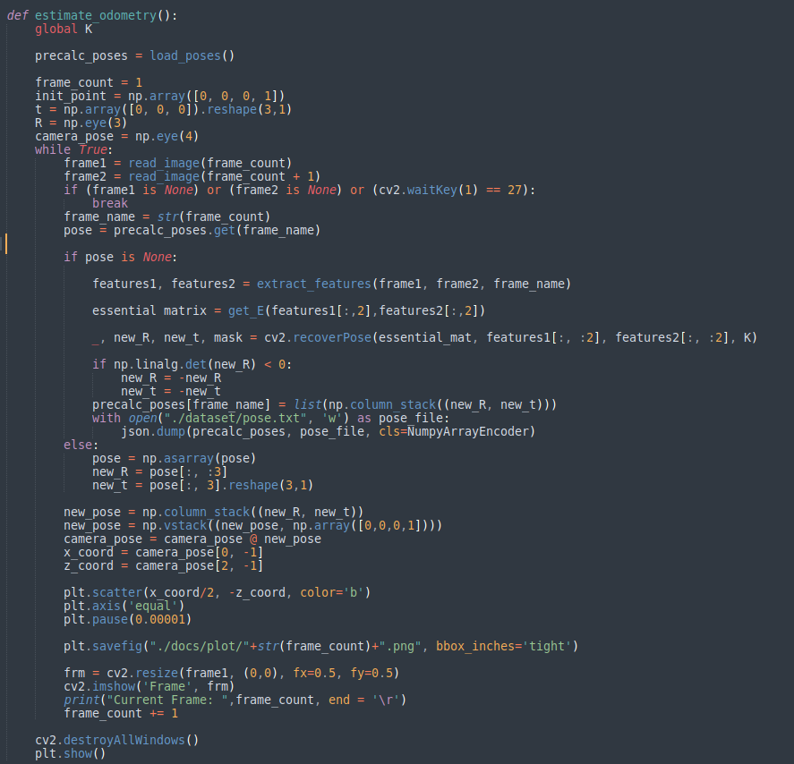
Code snippet - Part 1
Loads camera poses if available for the dataset. Useful if the code needs to be restarted due to computation reasons.
Initiates the code by loading the frame _{i} and frame _{i+1}

Slide 6
Code snippet - Part 2
Extract Features Using SIFT
Estimate the Essential Matrix.
Recover Correct Camera Pose

Slide 7
Code snippet - Part 3
Applies the Relative scale for the plot.
Saves the camera poses to a text file for further use.

Slide 8

Results on Oxford Robot Car Dataset
video link

Slide 9
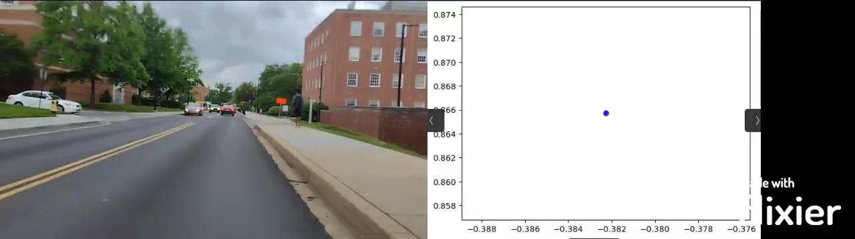
Results on Custom Dataset
video link

Slide 10
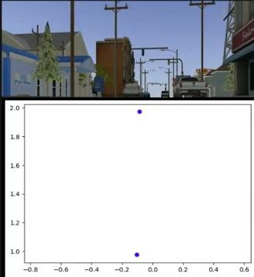
Results using Turtlebot3 Waffle_pi in Gazebo
Video Link

Slide 11
Difficulties Faced
Recovery of camera poses was at times incorrect.
Implementation in real time was found to be very difficult.

Slide 12
Future Works
Try to implement in real time on a real Robot.
Looks for ways to use other sensors to make it more accurate.

Slide 13
Thank you!
Questions?

